Slide 1
Module 3-TurkIsh PolItIcs SInce 1980 [1980-2010].

Slide 2
The End of the Second RepublIc and the MILITary Coup of 1980
The Beginning of the End: January 1980 Reform Package
The developments that led to the end of the 2nd republic and to the third military intervention in Turkish politics were manifold:
Increasing law and order problems
Kurdish separatism
A political system that seemed completely deadlocked
An economy in tatters
The growing influence of the Iranian Islamic revolution in Turkey

Slide 3
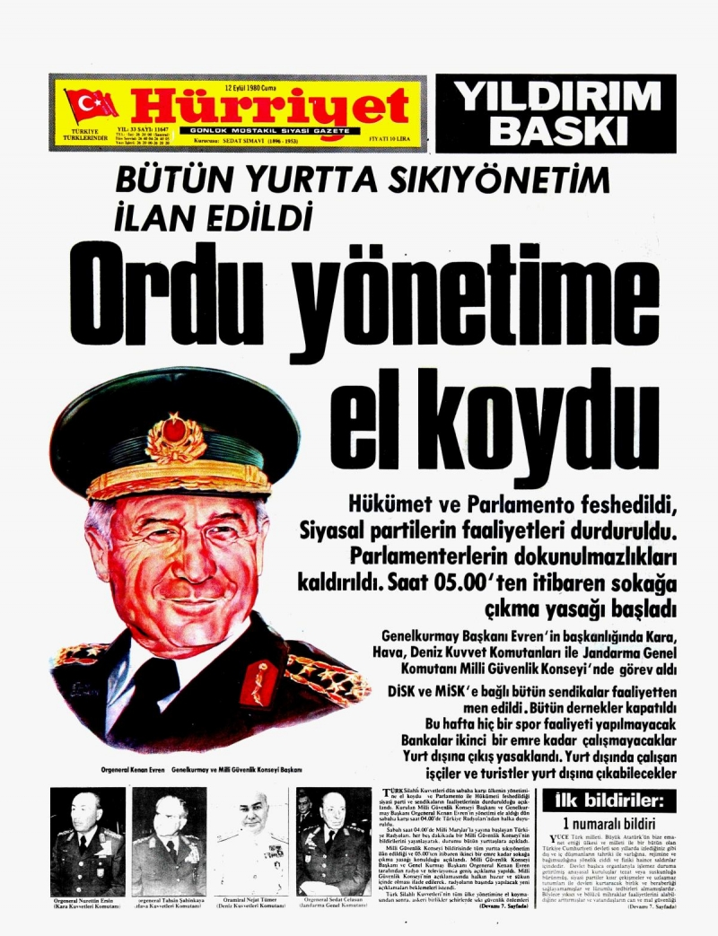
The Coup and Its Aftermath
The first communiqué read in the name of the junta on September 12 announced that the armed forces had taken over political power because the state organs had stopped functioning.
The parliament had been dissolved, the cabinet had been deposed and the immunity of the members of the national assembly (the parliament) had been lifted.
All political parties and the two radical trade union confederations (the socialist DİSK and the ultra-nationalist MİSK were suspended.
The political party leaders were arrested
A state of emergency was declared throughout the country and no one was allowed to leave.

Slide 4
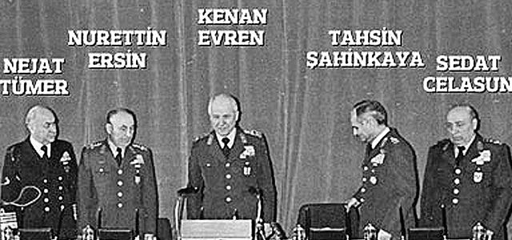
New PolItIcal ConfIguratIon after the Coup
All power was now concentrated in the hands of the military, more specifically in those of the National Security Council headed by the chief of staff, General Kenan Evren, who was officially declared head of state on 14 September.
A week later, the NSC, which now consisted of its military members only, appointed a 27-member cabinet under retired admiral Bülent Ulusu, but it was composed of bureaucrats and retired officers and there were no active or even former politicians among its members.
Under martial law, regional and local commanders were given very wide-ranging powers.

Slide 5
POLITICAL CLIMATE AFTER THE COUP
In June 1981 all public discussion of political matters was prohibited.
In 1982, an NSC decree forbade the old politicians to discuss publicly the past, the present or the future.
The old parties, which had been suspended after the coup, were officially dissolved on 16 October and their possessions were confiscated.

Slide 6
SuppressIon of terrorIsm and dIssent
A wave of arrests swept the country.
In the first six weeks after the coup 11,500 people were arrested; by the end of 1980 the number had grown to 30,000 and after one year 122,600 arrests had been made. By September 1982, two years after the coup, 80,000 were still in prison, 30,000 of them awaiting trial.
Although still strongly biased against the left, the anti-terrorist campaign was more even-handed than it had been during the period between 1971 and 1973: many members of Türkeş’s murderous street gangs, the ‘Idealists’ (Ülkücüler) commonly known as the Grey Wolves, were also arrested.
The universities were put under tight centralized control through the establishment of the Yüksek Öğretim Kurulu (Higher Education Authority), which directly appointed all rectors and deans.

Slide 7
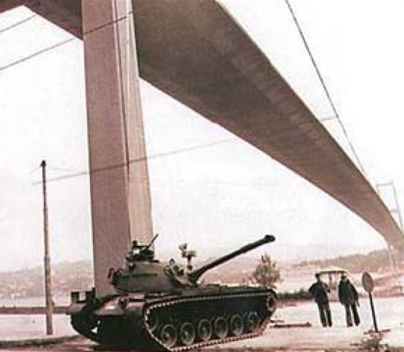

Slide 8
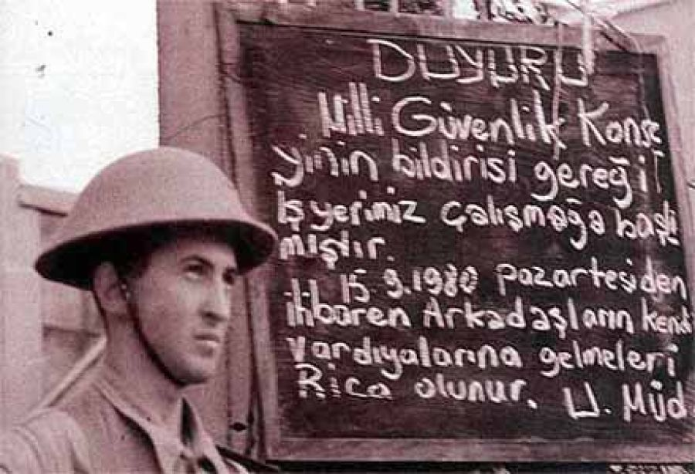

Slide 9
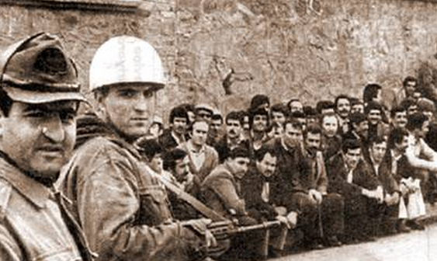
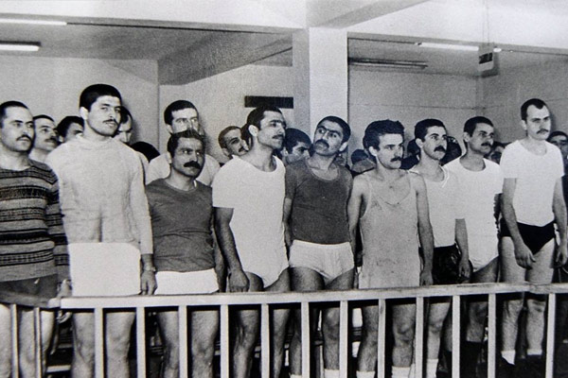

Slide 10
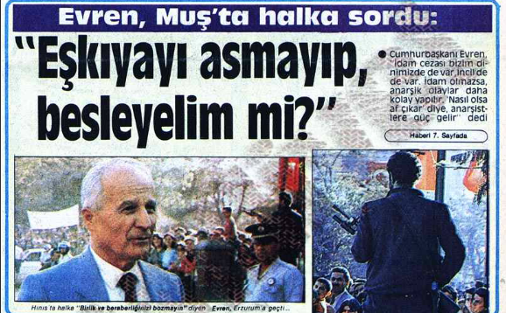
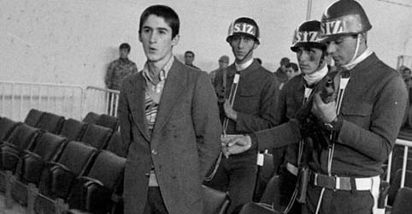

Slide 11
The New ConstItutIon of 1982
Powers of the Executive and NSC increased.
It limited the freedom of the press, the freedom of trade unions (banning political strikes, solidarity strikes and national strikes) and the rights and liberties of the individual.
Senate was closed down.
Referandum of the constitution was also making Kenan Evren the President.
91,4 %-YES vote.

Slide 12
Law on PolItIcal PartIes and THE NEW ElectIon LAW
Proportional Representation with a 10% threshold under the new election law of June 1983.
Politicians who had been active before September 1980 were banned from politics for ten years.
Approval of the NSC was needed.
Students, teachers and civil servants were barred from membership.
Parties were not allowed to found women and youth branches.

Slide 13



Democracy on a narrow road
Before the elections of 1983, 15 parties were founded, but the military deemed 12 of them unacceptable. Three parties that were allowed to take part in the elections of 6 November 1983 were:
Milliyetçi Demokrasi Partisi (Party of Nationalist Democracy) led by retired general Turgut Sunalp
Halkçı Partisi (Populist Party), led by Necdet Calp
Anavatan Partisi (Motherland Party), led by Turgut Özal

Slide 14
Motherland Party’s Electoral Success
Turgut Özal was behind the economic reform programme launched in 1979–80.
MP scored an overwhelming victory, polling over 45 per cent of the vote.
Özal’s election slogan, orta direk was devised to appeal to the average Turk who could identify with him.

Slide 15
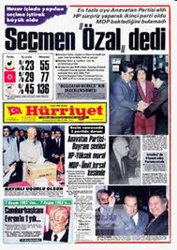
RIse of ANAP (MP) and Turgut Özal
1983 Elections-Beginning of a new Era after the military coup
Depoliticized society
United under Turkish-Islamic Synthesis
Neo-Liberal Economic Measures
ANAP was a conservative, traditionalist, nationalist party and it stood for social justice.
Catch-All Party
Local Elections of 1984-New Parties entered the race-SODEP, DYP, RP
Due to 1984 local elections-loss of legitimacy for the opposition in the parliament, thus after that they will try to restore that with dissolution, splits or unifications.

Slide 16
ELECTION RESULTS OF 1983 and 1984

Slide 17
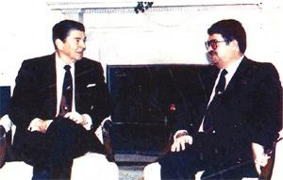
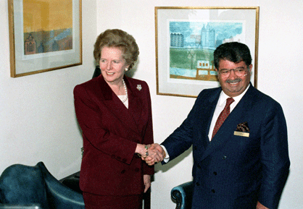
Export-OrIented LIves
24th of January 1980 Decisions –Export Oriented Economy
Restructuring Economy-foreign competition, opening up the economy and less state intervention
Neo-Liberalism in the World.
Military coup and economic measures
Özal and his economic program in 1980’s
Corruption and Nepotism

Slide 18
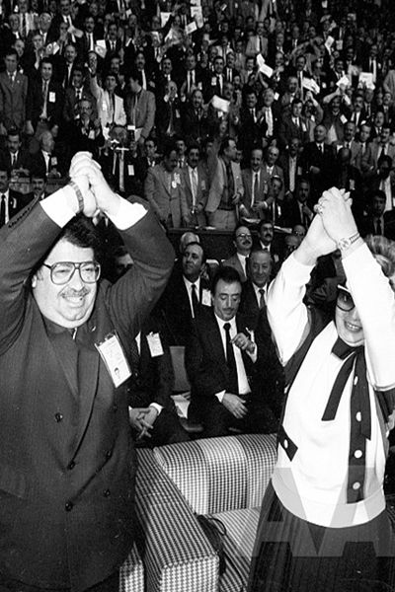
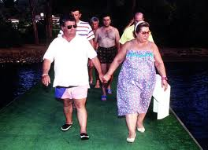
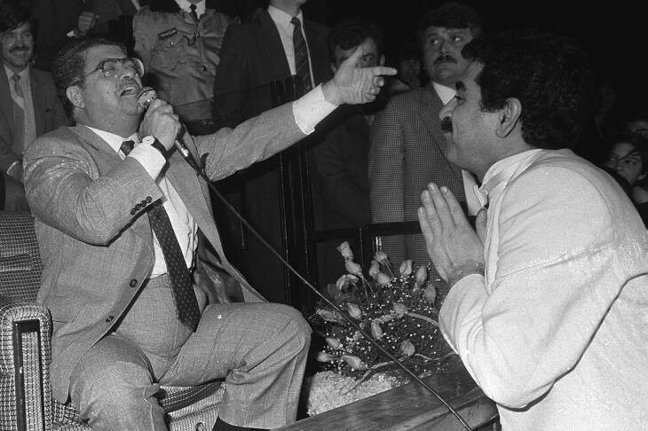
Return of the Old Guard and PresIdent Özal
Return of the Old Guard-1987 Referandum
Fall of support to Özal-Early elections of 1987 and local elections of 1989
Özal’s road to the Presidency
1991 Elections and Loss of ANAP
Death of Özal 1993

Slide 19
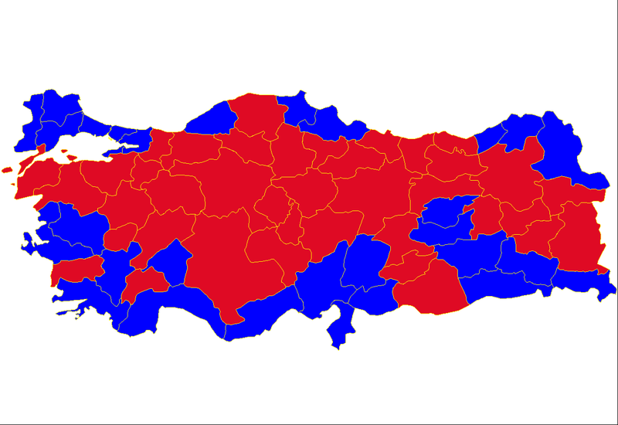
1987 Referendum
Choice | Votes | %
Yes | 11,711,461 | 50.2
No | 11,636,395 | 49.8
Notes:
Maviler Evet/ Kırmızılar Hayır

Slide 22
SecularIsm and PolItIcal Islam IN TURKEY
Secularism
The Anglo-American and French Versions
Laicite
Turkish Definition of Secularism

Slide 23
SecularIsm and PolItIcal Islam In Turkey
Early Republican Era
Secularist Reforms and their aims
Multi-party Era
Gradual Relaxation of secularist applications
1960’s and 1970’s-political representation of Islam
Necmettin Erbakan-MNP(NOP)/ MSP (NSP)
National View Movement/National Outlook Movement
1980’s and Turkish-Islamic Synthesis

Slide 24
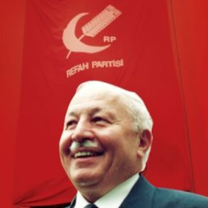
Welfare Party/Refah PartISI
Established in 1983
Entered to 1984 local elections
1987 Elections
Overview of 1980’s and Early 1990’s that led to the rise of WP

Slide 25
Ideology and OrganiIZatIonal Structure of Welfare Party:
Just Order
Emphasis on National Pride
Ability to Respond to Conflicting Identities and Ethnic Tension
Inability of other parties in adressing the needs of the population
Effective Organisation
String (teşbih) model.

Slide 26
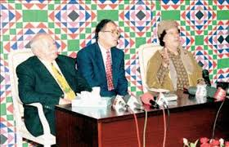
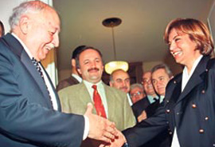
RIse of Welfare Party
1994 Local Elections
28 of 76 mayoral seats
Social municipalities
White Desk
People’s Assemblies
1995 Elections- Welfare Party became the 1st Party
ANAYOL government
REFAHYOL government

Slide 29
The polITICAL Success of WP:
Increasing role of Islam in Turkish public life.
State repression of religious expression had galvanized Islamist activisim.
Voter dissatisfaction with the performance of the centrist parties and revelations about government, corruption, cronyism and inefficiency.
Support from, smaller towns of Central and Eastern Anatolia, but also from major cities from secular left parties.
Voter base expanded from conservative rural people and small businessmen to include big business owners, young urban professionals, women intellectuals and crossovers from the left.
Image of a modern party rather than a religious party.
Success of local grassroots organizations and women branches.
Support for Kurdish linguistic and cultural rights, protection of the environment and the elimination of social inequality and corruption.

Slide 30
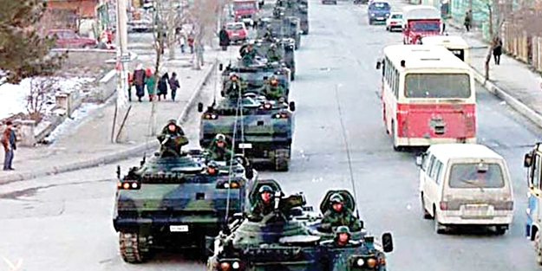

Slide 31
28th of February-Soft Coup/Post-Modern Coup
NSC Meeting and demands from Erbakan government.
Why Post-Modern?
The military mobilized major business associations and media cartels, university rectors and judiciary long subservient to its commands to engineer an anti-RP drive to force the recently elected Erbakan to resign.
28th of February Process
This was known not only as a coup but as a process, because it was not limited to the removal of RP government, but was also a process for the state establishment, mainly the military and civilian bureaucracy, to monitor, control and criminalize all Islamic activism as a security threat and institutionalize a permanent legal framework for ostracizing devout and or active Turkish Muslims from market, educational and political spheres

Slide 32
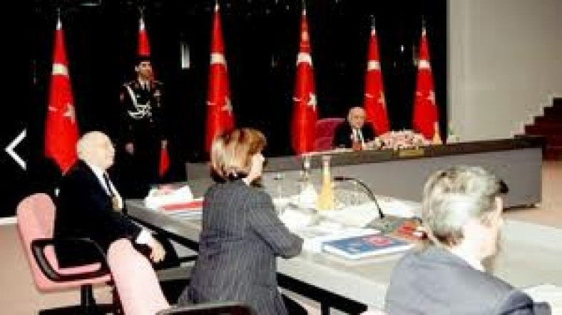

Slide 33
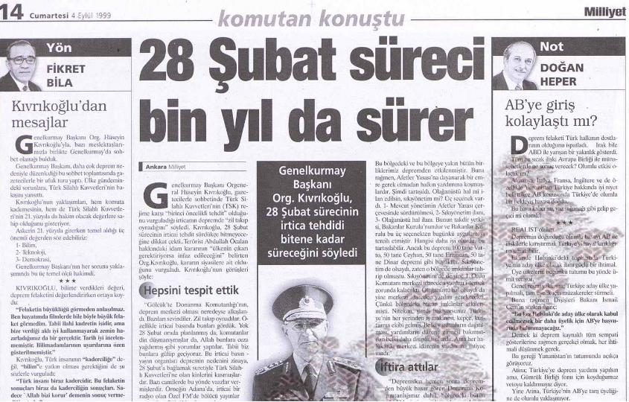

Slide 34
NatIonal ElectIons In 1990’s
1995 G. Election | RP (%21.4) | ANAP (%19.6) | DYP (%19.8) | DSP (%14.6) | CHP (%10.7)
1999 G. Election | DSP (%22.2) | MHP (%18) | FP (%15.4) | ANAP (%13.2) | DYP (%12)

Slide 35
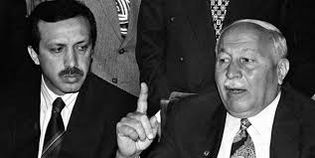
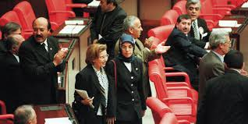
The Legacy of Welfare Party and Road to JustIce and Development Party:
Virtue Party (Fazilet Partisi)-Recai Kutan
The Renewers (Yenilikçiler)
The Traditionalists (Gelenekçiler)
Merve Kavakçı Incident-1999

Slide 36
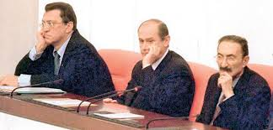
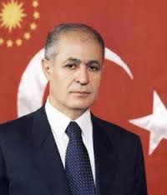
1999-2002 In TurkIsh PolItIcs
1999 Elections
New Coalition-DSP-ANAP-MHP
Ahmet Necdet Sezer became the new President-2000
Economic Crisis of 2001

Slide 37
AKP (JDP) and The nEW VISION OF tHe PARTY
Conservative-Democrats and focus on democracy
A pro-Western Foreign Policy vision
Free-market Economy
Soft-Secularism

Slide 38
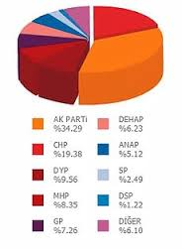
VIctory of AKP (JDP)
2002 Elections and AKP Victory

Slide 39
Reasons for Success of AKP
The AKP is an outcome of the transformation of Liberal Islam directed by 4 socio-political factors:
The new Anatolian bourgeoisie.
The expansion of public sphere and the New Muslim Intellectuals.
The Copenhagen Criteria and EU Reforms
The February 28th Coup.

Slide 40
2002-2007 AKP GOVERNMENT
Economy
EU Relations
Iraq War (2003)
Presidential Elections of 2007
April 2007-E-Memorandum and Relations with the Military

Slide 41
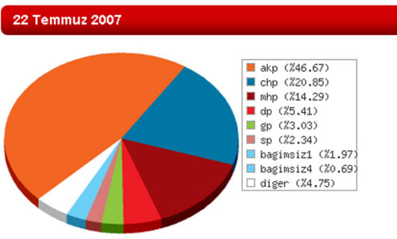
2007 ELECTIONS

Slide 42

Notes:
Tinerci Nesil VS. Dindar Nesil?

Slide 43
